Slide 2
Synergize your AI Technology Stack
SAS Presents
Smart processes powered end-to-end by AI

Slide 3

Seamless integration between AI elements

Slide 4
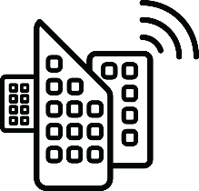







The Integrated AI Technology Stack
Intelligence end-to-end
Data
Insight
Speed

Slide 5
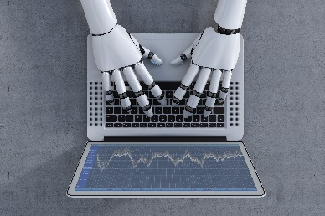



Use cases
Banking
Manufacturing
Government
Retail

Slide 6
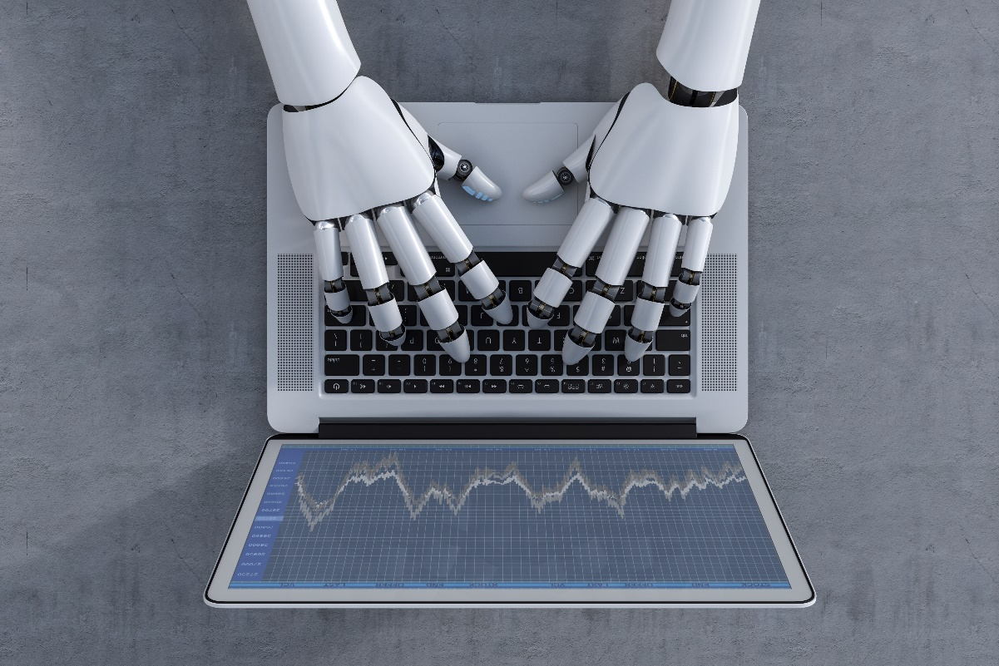
End-to-end AI in Banking
Example: Robo Advisors
Big data
Alternative data
Image data
Text data
Supervised ML
Recommendation engines
Automation
Natural language parsing
Natural language generation
On-demand financial advice at scale

Slide 7










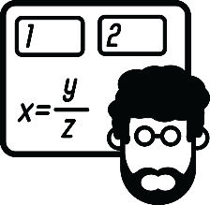
The Robo-Advisor Technology Stack
From data to model to consumer

Slide 8
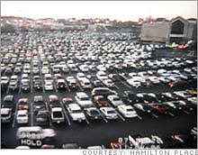

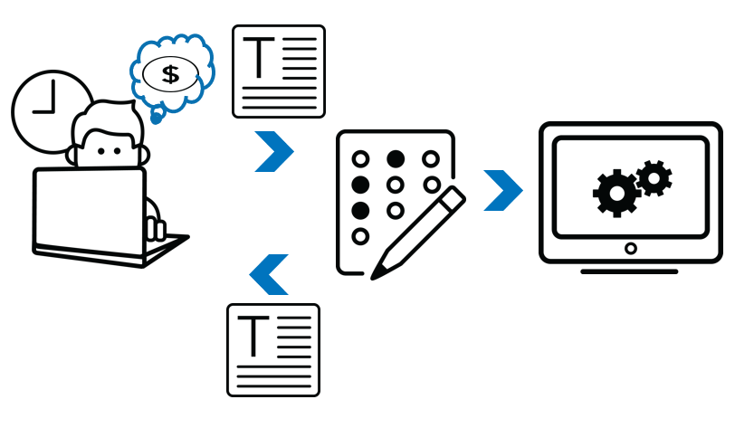
Computer vision in asset management

Slide 9
Where else in Banking?
Everywhere
Credit decisioning
Alternative data: text, image
Supervised ML models for accurate decisioning
Decisions on-demand
Interactive interfaces
Market risk
Data quality
Identifying proxies and hedges
Valuation methodologies
Real-time, pre-deal risk metrics

Slide 10
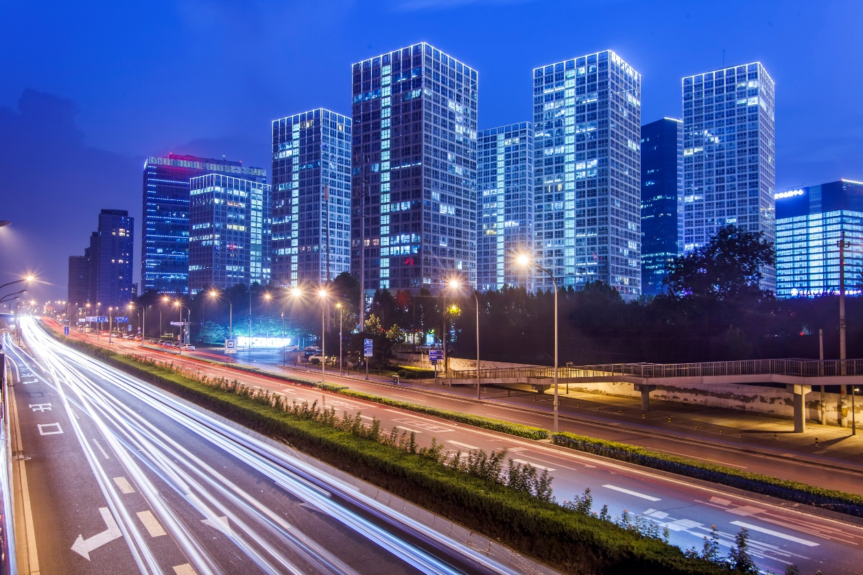
End-to-end AI in Government
Example: Smart Cities
Computer vision
Predict movement
Data velocity
Real-time management
Natural language generation
Reinforcement learning
Modern management of places and resources

Slide 11
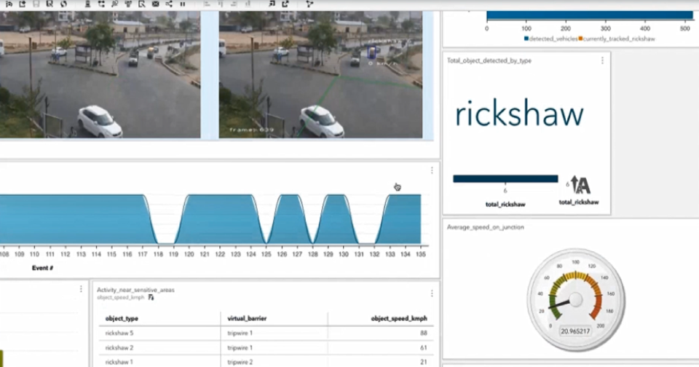
Video demo: SAS Smart Cities India Traffic

Slide 12
Where else in Government
Lots of places
Water resources
Computer vision
Predictive maintenance
Forecast usage
Customer utility interface
Food safety
Text analytics
Computer vision
Predicting risk and impact

Slide 13

End-to-end AI in Manufacturing
Example: Asset monitoring
Computer vision
Audio processing
Forecasting
Real-time management
Real-time feedback of performance

Slide 14
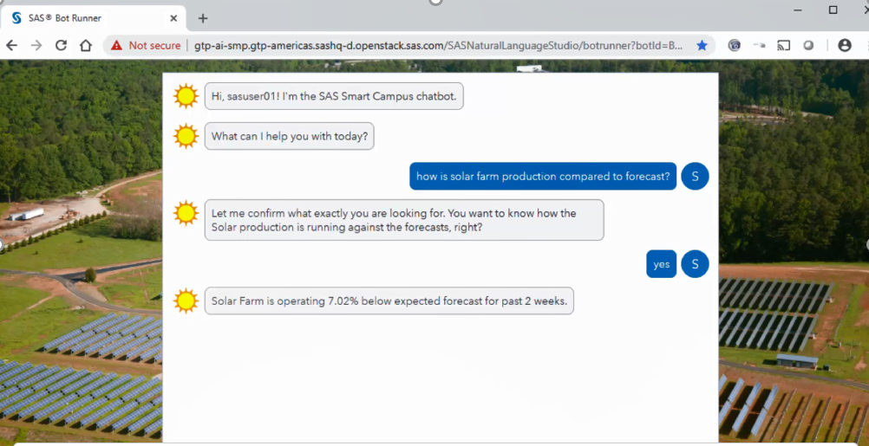

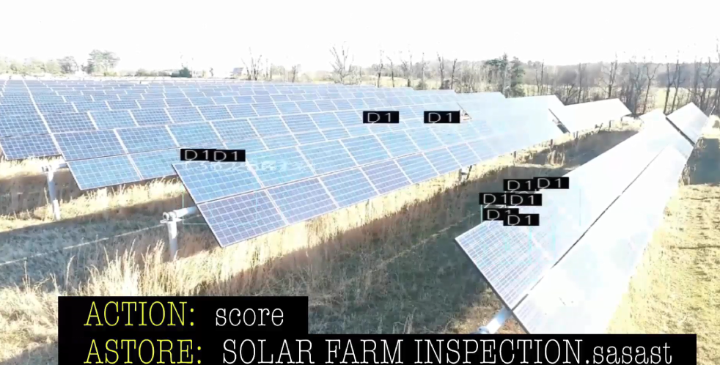
Video Demo: SAS solar farm monitoring

Slide 15
Where else in Manufacturing
Predictive maintenance
Sensors embedded to automate monitoring
Computer vision, audio processing
Classify asset condition
Predictive ML models

Slide 16

End-to-end AI in Retail
Example: Knowing your customer
Computer vision
Audio processing
Forecasting
Real-time management
Anticipate customer need and achieve sales

Slide 17
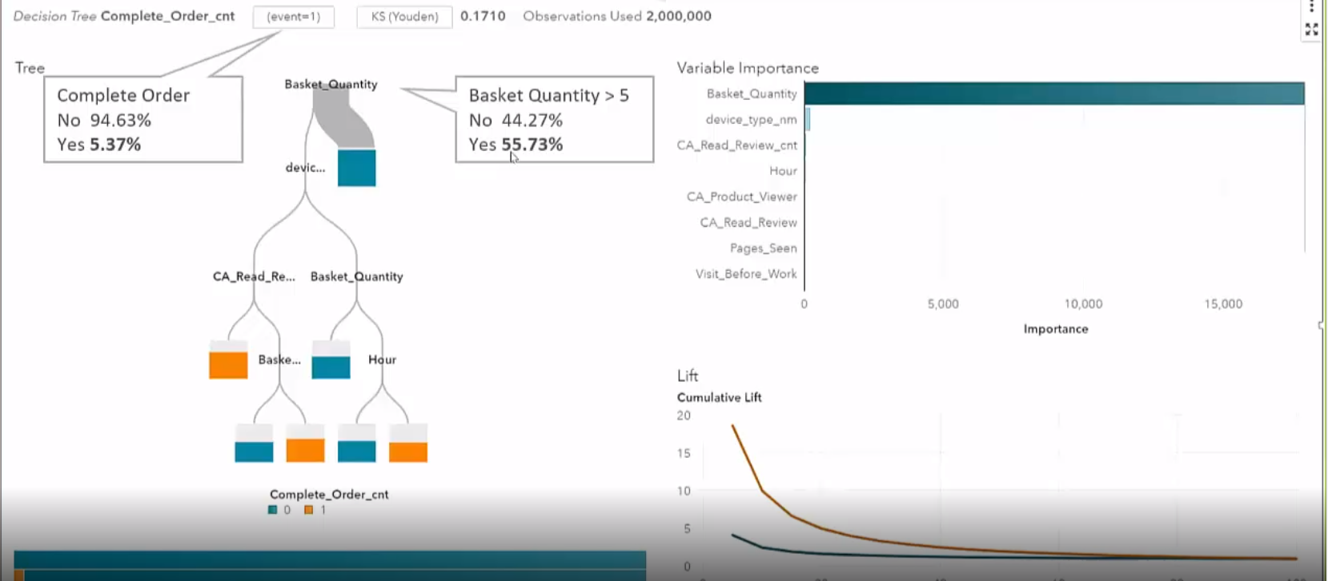
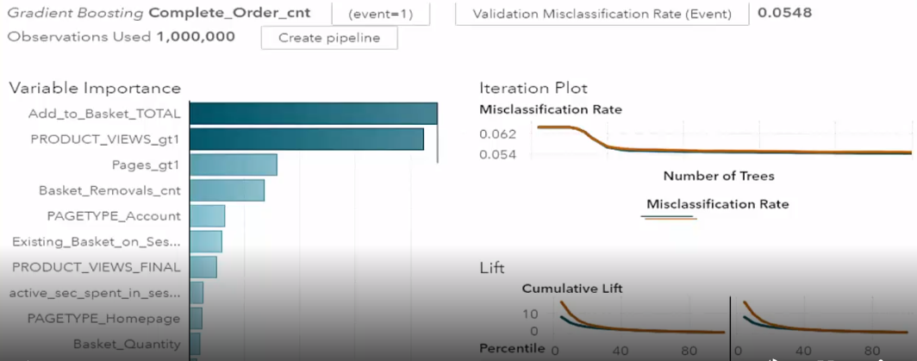
Anticipating the customer’s next action

Slide 18


Achieving the Integrated AI Technology Stack
Intelligence end-to-end
Integration for development
Integration for discovery
Integration for decisioning

Slide 19
Thank you

